Slide 1
How to Make Downloading Faster
(Automatic Transition To Peer-to-Peer Download)
Notes:
When the server can’t

Slide 2
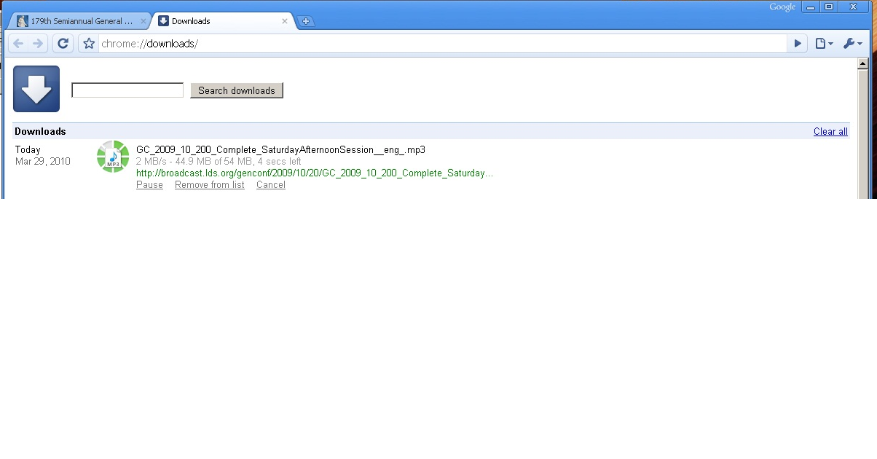
Fast download

Slide 3
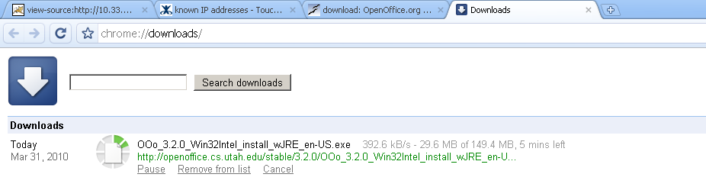
Slow downloads
Notes:
What options do you have?
Go and do something else.
Add a graph of network speed increasing so slowly compared to processors [?]

Slide 4
Options
Hit reload.
Go somewhere else.
Download Manager.
Add a local proxy.
New internet connection.
Beg the server to change how they serve the file.
I now give you another option.
Notes:
Download manager—for me speeds things up, but hard to use because not integrated, also the server might run out of bandwidth.

Slide 5
Server options
Buy more servers/move
CDN
Buy more bandwidth.
Turn to P2P.
Notes:
More servers closer to you.

Slide 6
P2P
Create BitTorrent File.
Host it, with tracker.
Peers share.
Barrier to use.
Notes:
TODO: pictures
Barrier: not just the client, but you don’t know if using the client will actually be faster. Many times it isn’t.
And some sites don’t offer P2P.
Technology is there but not easily accessible.
How many sites actually offer you that stuff?

Slide 7
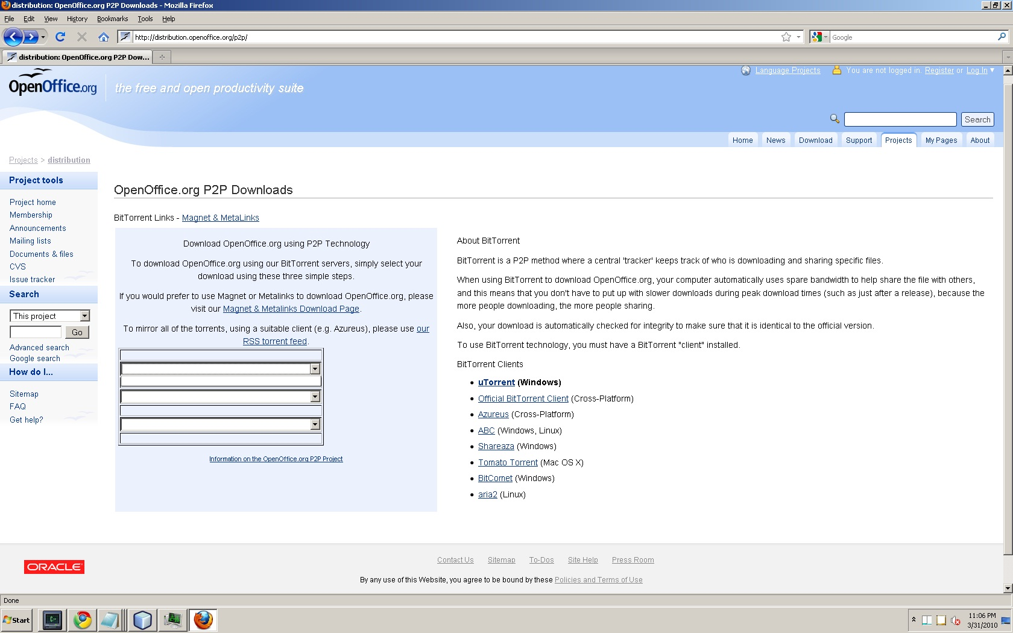
Hard
Notes:
Barrier to entry: know how to use it, choose it, and it has to be fast. Many people ignore it.

